Slide 1
Python Libraries
Session 5

Slide 2
Python Library
A library is a collection of modules containing functions, classes, and methods.
Simplify common programming tasks.
Save time with ready-to-use code.
Make coding faster and more efficient.
Used in various fields, including data science, web development,and machine learning.

Slide 3
Methods to import library
You can import libraries in three main ways:
Import the entire library: import library_name for example,
    import math
Import a specific function or class: from library_name import function_name for example,
    from math import sqrt
Import a library with an alias: import library_name as alias, alias means giving a library a shorter or different name using the as keyword. for example,
    import pandas as pd

Slide 4
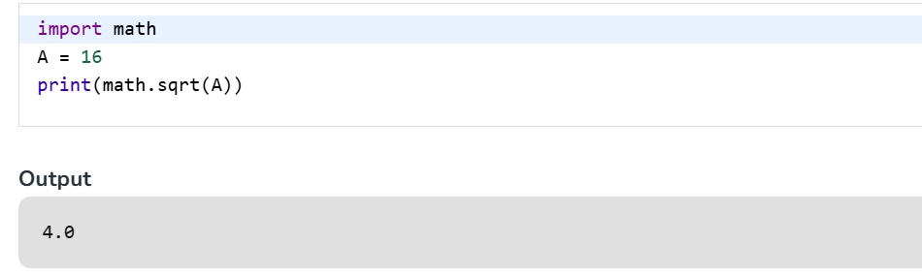
Import the entire library
Example 1: This program imports the entire math library and uses one of its functions.
math library is imported and math.sqrt() is used to calculate the square root of 16.Since the full library is imported, we must prefix the function with the library name (math.).

Slide 5
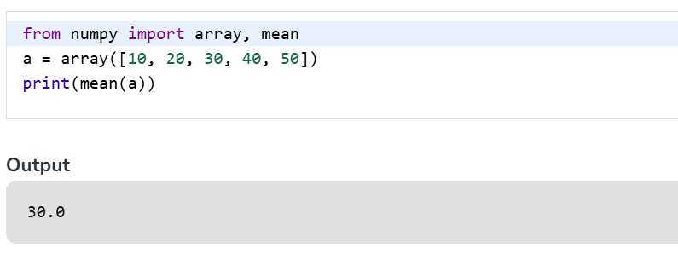
Import a specific function or class
Example 2: This program imports only selected functions from an external library to simplify usage.
array() is used to create a NumPy array from a list and mean() calculates the average value of all elements in the array.

Slide 6
Random library
Example: Here Python's built-in random library is imported and used its randint() function to generate a random number between 1 and 10.

Slide 7
Numpy
NumPy stands for Numerical Python.
It is a Python library used for mathematical calculations.
It works with arrays to store and process data.
NumPy is usually faster than Python lists for numerical operations.
It is widely used in data science, AI, and machine learning.

Slide 8
Numpy Installation
Installation
To begin using NumPy, you need to install it first. This can be done using the following pip command:
  pip install numpy
Once installed, import the library with the alias np
  import numpy as np

Slide 9
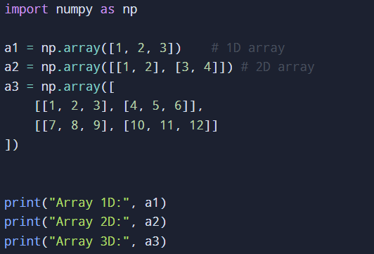
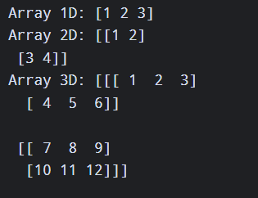
Creating NumPy Arrays

Slide 10
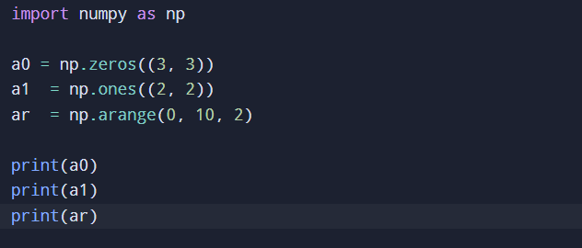
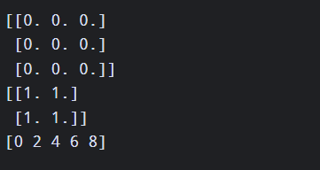
Using Numpy Functions
NumPy provides quick utility functions for creating arrays filled with zeros, ones, or ranges:

Slide 11
Pandas
Open-source Python library for data analysis and manipulation.
Helps clean and organize data.
Works with tabular data like spreadsheets and SQL tables.
Provides fast and flexible data-handling tools.

Slide 12
Pandas
Before using Pandas, make sure it is installed:
  pip install pandas
After the Pandas have been installed in the system we need to import the library. The Pandas library can be imported using:
  import pandas as pd

Slide 13
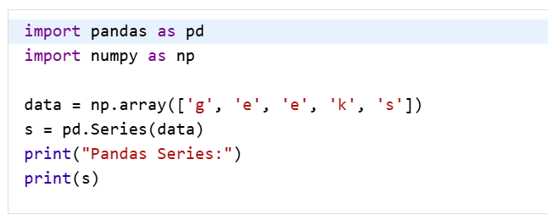
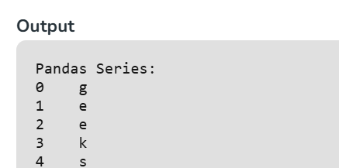
Data Structures in Pandas
1. Pandas Series
  A Series is a one-dimensional data structure in Pandas.
  It stores data with labelled indexes.
  It can be created from lists, arrays, or dictionaries.
  The labels associated with a Series are called its index.

Slide 14
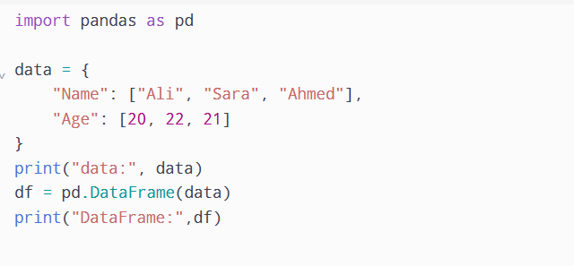
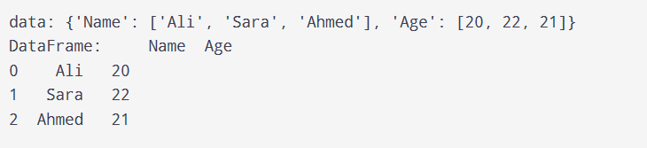
Data Structures in Pandas
2. Pandas DataFrame
  Pandas DataFrame is a two-dimensional data structure with labeled axes (rows and columns).
  It is created by loading the datasets from existing storage which can be a SQL database, a CSV file or an Excel file.
  It can be created from lists, dictionaries, a list of dictionaries etc.
Notes:
Creates a NumPy array containing character values.
Uses pd.Series() to convert the array into a Pandas Series.
Each element is assigned a default integer index starting from 0.

Slide 15
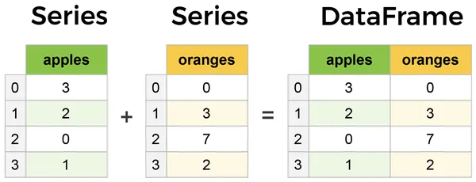
Pandas Series Vs Dataframe
Notes:
Creates a NumPy array containing character values.
Uses pd.Series() to convert the array into a Pandas Series.
Each element is assigned a default integer index starting from 0.

Slide 16
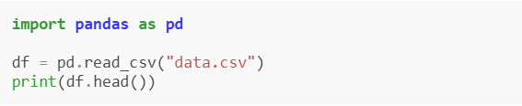
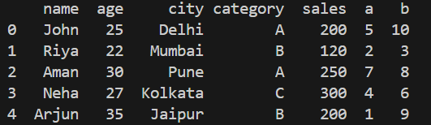
Operations in Pandas
1. Loading Data: Loading Data is the process of reading data from files such as CSV, Excel, or JSON into a Pandas DataFrame for analysis and processing.
You can download the data.csv file from here
Notes:
pd.read_csv("data.csv") reads the CSV file and loads it into a DataFrame and df.head() shows the first 5 rows of the data.

Slide 17
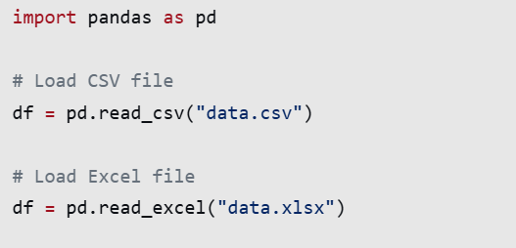
Data Loading
Supports multiple file formats.
Stores data in a Pandas DataFrame.
head() displays the first five rows by default.
Makes data ready for analysis and manipulation.

Slide 18
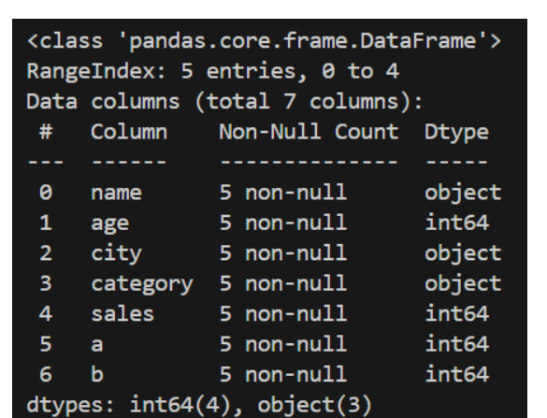
Operations in Pandas
2. Viewing and Exploring Data: After loading data, it is important to understand its structure and content. This methods allow you to inspect rows, summary statistics and metadata.

Slide 19
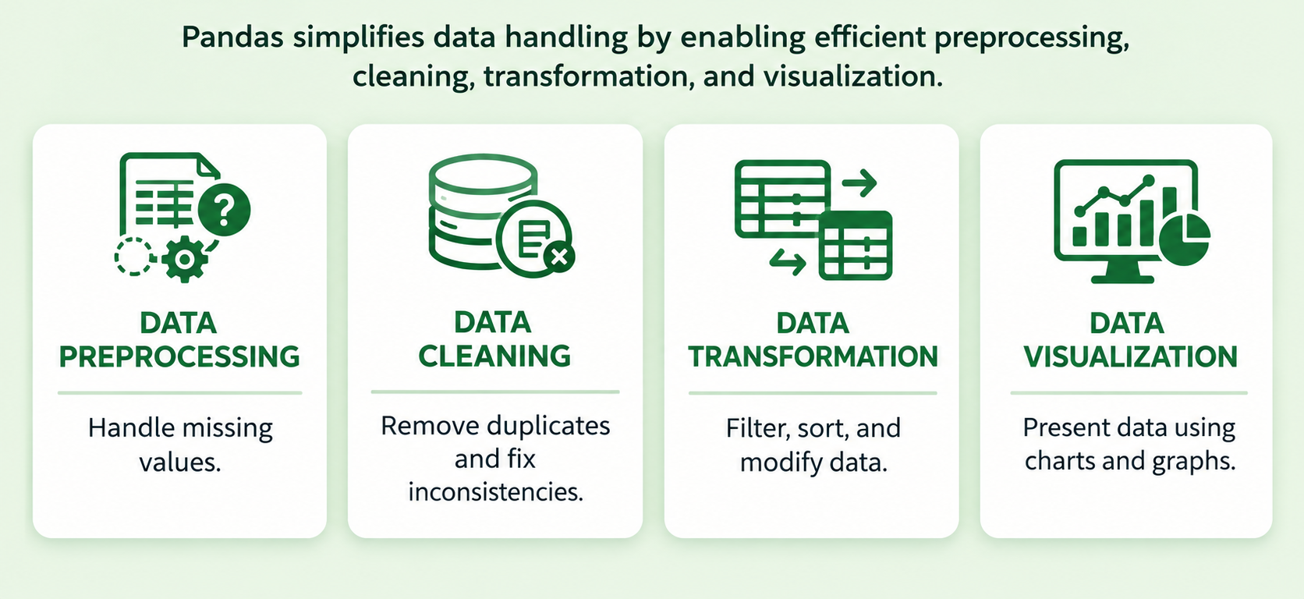
Pandas Basic Operation

Slide 20
Data Preprocessing
Data preprocessing is the process of preparing raw data for analysis.
  Handle missing values.
  Organize data into rows and columns.
  Prepare data for further processing.

Slide 21
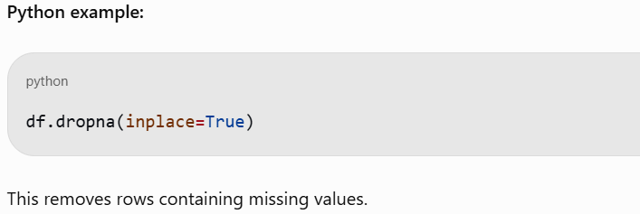
Data Preprocessing
Handling Missing Values
Missing values occur when some data entries are empty or unavailable.
Common methods:
Remove missing values.
Replace them with the mean, median, or mode.
Fill missing values with a specific value.

Slide 22
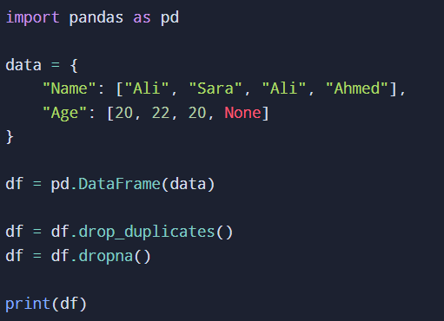
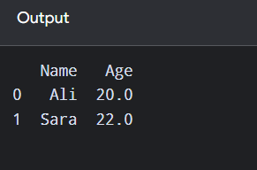
Data Cleaning
Data cleaning improves data quality by finding and fixing errors.
  Remove duplicate records.
  Correct inconsistent data.
  Code:

Slide 23
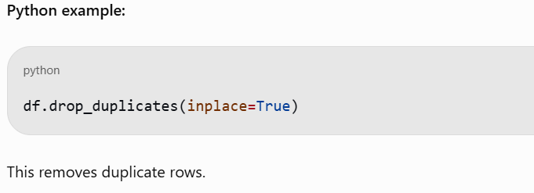
Data Preprocessing
Removing Duplicate Data
Duplicate data occurs when the same record appears more than once.
Why is it important?
Prevents repeated records.
Improves data accuracy.
Avoids misleading analysis.
Notes:
inplace=True means make changes directly to the original DataFrame instead of creating a new one.

Slide 24
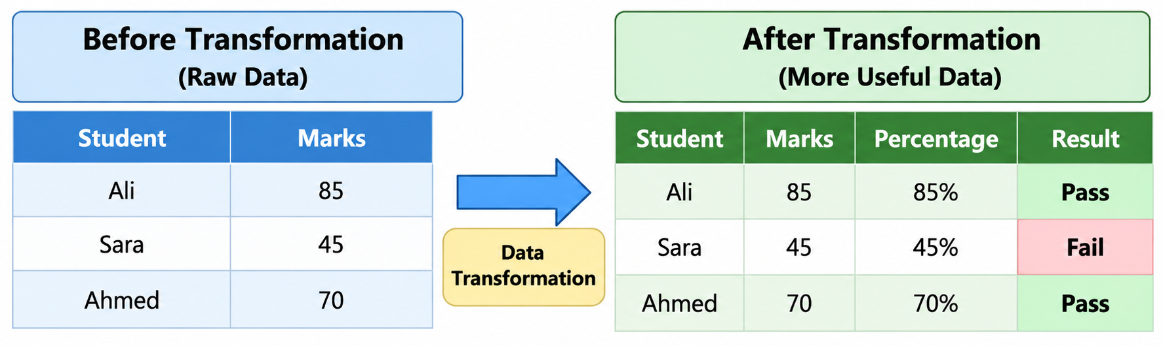
Data Transformation
Definition: Data transformation is the process of converting data from one format, structure, or scale into another format to make it suitable for analysis.
Why is it important?
Improves data consistency.
Makes data easier to analyze.
Converts data into suitable formats.
Helps prepare data for machine learning.

Slide 25
Data visualization
Data visualization presents information using charts and graphs.
Compare values using bar charts.
Show trends using line charts.
Understand patterns in data.

Slide 26
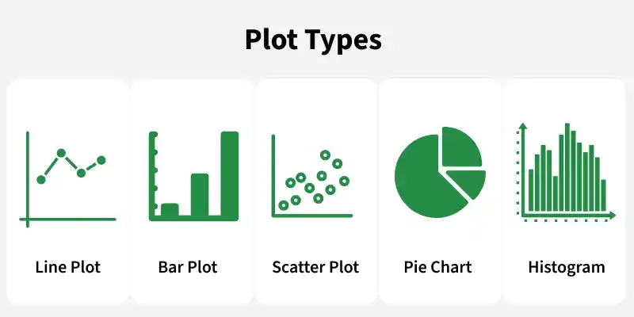
Matplotlib
Matplotlib is Python's foundational, open-source library for creating static, animated, and interactive data visualizations.

Slide 27
Matplotlib Pyplot
Pyplot is a module within Matplotlib that provides a MATLAB-like interface for making plots. It simplifies the process of adding plot elements such as lines, images and text to the axes of the current figure.

Slide 28
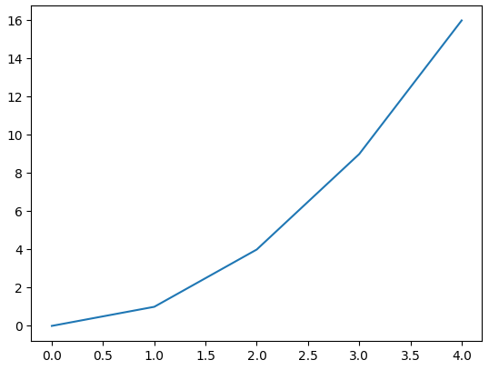
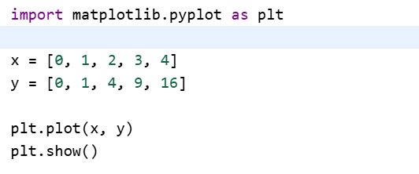
Example: Let's create a simple line plot using Matplotlib, showcasing the ease with which you can visualize data.

Slide 29
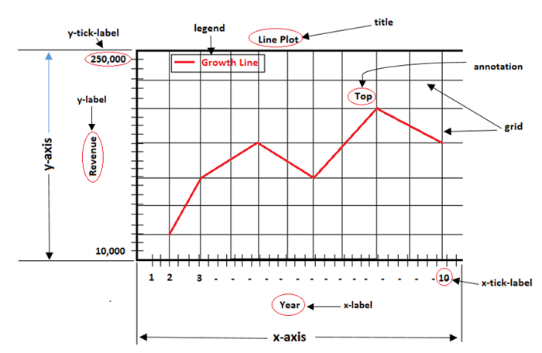
Components or Parts of Matplotlib Figure
Anatomy of a Matplotlib Plot: This section dives into the key components of a Matplotlib plot, including figures, axes, titles and legends, essential for effective data visualization.

Slide 30
Key components of a Matplotlib
Figure: The overarching container that holds all plot elements, acting as the canvas for visualizations.
Axes: The areas within the figure where data is plotted; each figure can contain multiple axes.
Axis: Represents the x-axis and y-axis, defining limits, tick locations and labels for data interpretation.
Lines and Markers: Lines connect data points to show trends, while markers denote individual data points in plots like scatter plots.
Title and Labels: The title provides context for the plot, while axis labels describe what data is being represented on each axis.

Slide 31
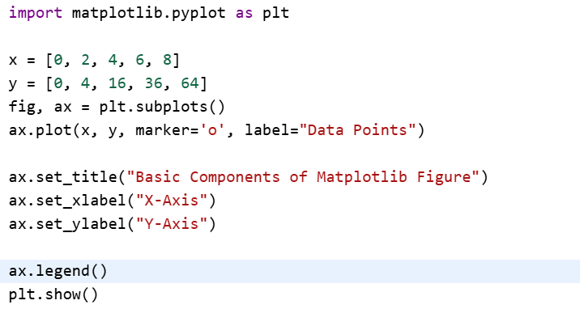
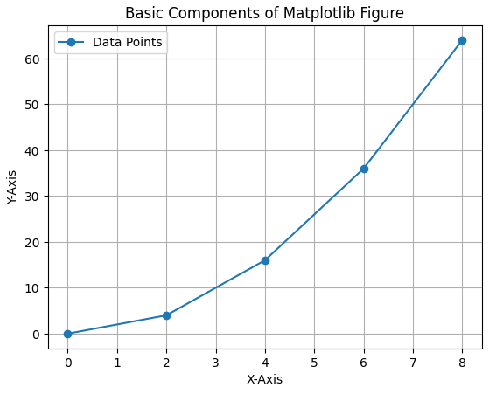
Example

Slide 32
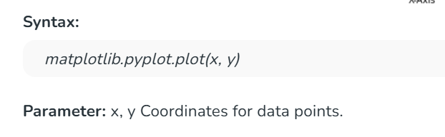
Different Types of Plots in Matplotlib
1. Line Chart: Line chart is one of the basic plots and can be created using plot() function. It is used to represent a relationship between two data X and Y on a different axis.

Slide 33
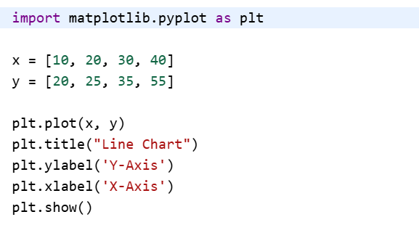
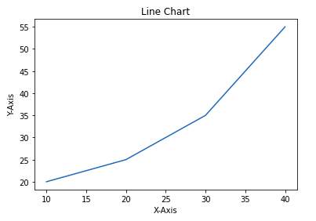
Line Chart
Example: This code plots a simple line chart with labeled axes and a title using Matplotlib.

Slide 34
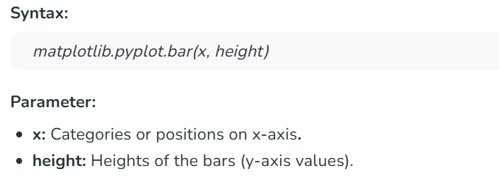
Bar Chart
Bar chart displays categorical data using rectangular bars whose lengths are proportional to the values they represent. It can be plotted vertically or horizontally to compare different categories.

Slide 35
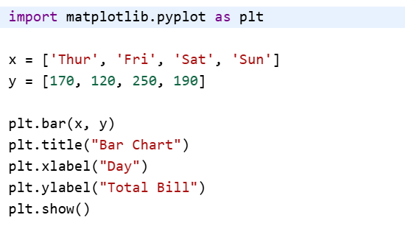
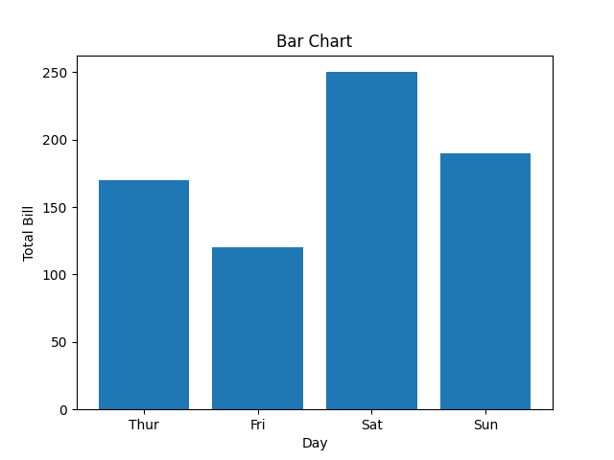
Bar Chart
Example: This code creates a simple bar chart to show total bills for different days. X-axis represents the days and Y-axis shows total bill amount.

